Slide 1
Stochastic Calculus for Finance II
Steven E. Shreve
6.5 Interest Rate Models (1)
交大財金所碩一 許嵐鈞

Slide 2

Short-rate models
Simplest models for fixed income markets:
Risk-neutral measures & risk-neutral pricing formula:
discounted assets prices are martingales.
R(t) is for short-term borrowing.
One factor model: R(t) determined by only 1 stochastic differential equation, cannot capture complicated yield curve behavior.
May21, 2008

Slide 3





Review: discount process
Discount process:
Money market account price process:
May21, 2008
Notes:
Money market account：期初存$1，在時間等於t時帳戶所持有金額

Slide 4



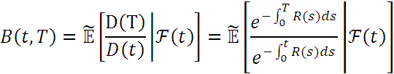


Zero-coupon bond pricing formula
Risk-neutral pricing formula:
Zero-coupon bond pricing formula:
May21, 2008
Notes:
B( t, T)=V(t) B(T,T)=1代入(5.2.30)，即可滿足(6.5.2)

Slide 5





Yield
Define the constant rate of continuously interest between time t and T as yield:
equivalently,
Short rate decided by (6.5.1), long rate determined by the formula above; no long rate model separately.
R is given by SDE, it is a Markov process (P.267 Corollary 6.3.2)
so
May21, 2008

Slide 6

Find the PDE of unknown
Review: P.269, principle behind Feynman-Kac Theorem:
    find the martingale
    take the differential
    set the dt term to zero
    Then we will have a PDE, which can be solved numerically.
  Feynman-Kac Theorem: relates SDE and PDE.
  Numerical algorithm: converge quickly in one-dimension, and give the function g(t,x) of all (t,x) simultaneously.
May21, 2008

Slide 7





Find the PDE of unknown
    Find the martingale:
  Take the differential:
  Set dt term to zero:
Terminal condition:
May21, 2008

Slide 8




Hull-White interest model
SDE of R(t):
so PDE for the zero coupon bond:
Guess the solution has the form: (verify later)
C(t, T) and A(t, T) are nonrandom functions to be determined
May21, 2008

Slide 9




Hull-White interest model
Yield: (constant rate of continuously interest between time t and T)
is an “affine” function
Hull-White model is a special case of “affine yield function”.
May21, 2008
Notes:
affine: 相對於linear
在利率模型中，linear指通過原點的直線，affine則有截距

Slide 10

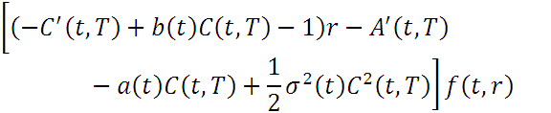

Hull-White interest model
Substitute into (6.5.6),
The equation must hold for all r, so
substitute back into (6.5.7), then
May21, 2008

Slide 11







Hull-White interest model
The ODE and the terminal condition
(because (6.5.5)holds for all r) can solve
In conclusion, we have an explicit formula for the price of a zero-coupon bond as a function of R(t) in Hull-White model:
May21, 2008

Slide 12







Exercise 6.3 (Solution of Hull-White model)
May21, 2008

Slide 13





Exercise 6.3 (Solution of Hull-White model)
May21, 2008
Notes:
f(t ,r)=exp( -r*C-A) 所以t=T時，C(T,T)=A(T,T)=0

Slide 14





Exercise 6.3 (Solution of Hull-White model)
May21, 2008
Notes:
解A( t, T)之微分方程，因為等號右邊沒有A( t, T)，故照一般解法即可，不用像解C( t, T)一樣

